Slide 1
Reconstruction & Its’ Aftermath
8-8 Reconstruction’s Legacy

Slide 2
Reconstruction Slideshow
Directions:
You will create a 5 slide presentation using Google Slides®. Each slide must contain the following:
1) The Title
2) The answers to the questions, number and in complete sentence format.
3) 1 image relevant to the topic for each slide (do not use pictures from this PowerPoint or any other one used in class)

Slide 3
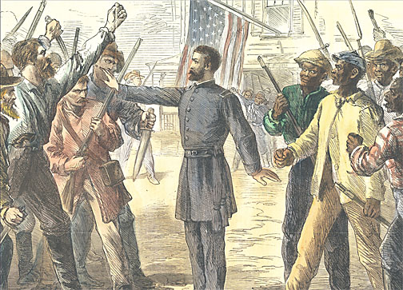
Freedmen’s Bureau
What did the Freedmen’s Bureau do for poor whites and blacks?
Was it successful?
Why did the bill that supported it get so much “heat” from President Johnson?

Slide 4
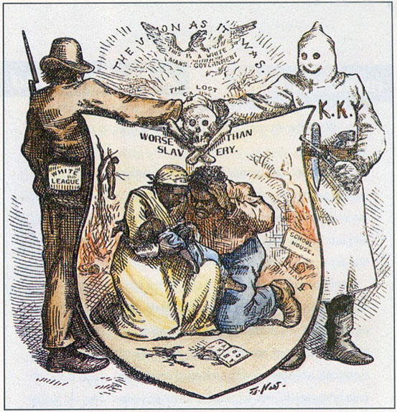
Ku Klux Klan
What did the KKK stand for?
What are they all about?
What were the KKK’s goals?
What did the KKK do to African –Americans and WHY?
Why did the group also target whites?
When did the violence always increase and why?

Slide 5
“Reconstruction Amendments”
Define each amendment.
13th
14th
15th
What were the goals of the Reconstruction amendments?
Who opposed them and who wanted them?

Slide 6
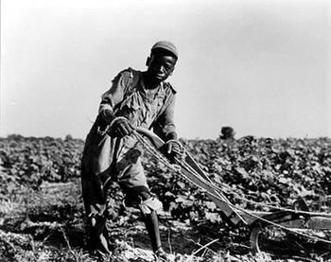
Sharecropping
What was the system of sharecropping for poor whites and blacks?
How was it similar to slavery?
What was the African American’s viewpoint on sharecropping?

Slide 7
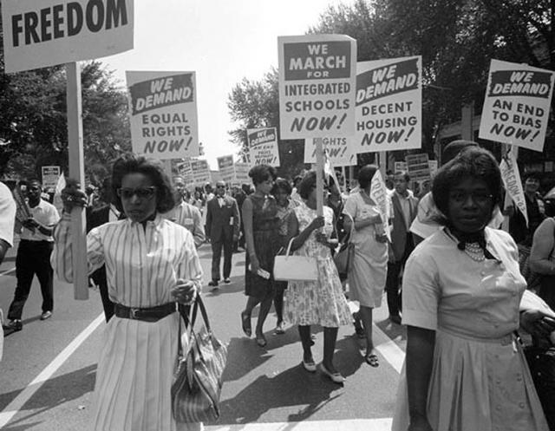
Reconstruction’s Legacy
List the Positives that came out of the Reconstruction Era.
List the Negatives that came out of the Reconstruction Era.
OVERALL, how do you see Reconstruction?
Is it a positive or negative and why?

