Slide 1
9-14 Causes of… The Great War
Simulation and Geography of Europe at the start of the First World War

Slide 2
Simulation Rules and Expectations
Rules:
You must follow all instructions very carefully
No horseplay
Stay within your group’s area unless otherwise instructed…
Use inside voices
Be competitive but respectful

Slide 3
Be proud!
You will be given 5 minutes, as a group write a national anthem for your country.
Your country will then sing your anthem
Points will be awarded on the loudest and the best anthem

Slide 4
Claim what is yours!
You will be given 5 minutes
On the 1/4 sheets provided draw as many of your country’s flags in COLOR as you can!!!
As you make flags, 4 people from your group will claim territories around the room!
Points for who claims the most in each area!

Slide 5
Army Strong!
Using the flags you created you will have 5 minutes to build up your “army”
Your active army will be measured by how many “paper balls” you can make from your flags
Your reserve army will be measure by how many of your flags you can tape “end to end” in a chain
Points for the winner!

Slide 6
And the winner is…

Slide 7
Serbia
Gavrillo Princip assassinates Archduke Franz Ferdinand!

Slide 8
Recap
In your group: What did each simulation represent?
Record this info on the chart on the back of your map
Share as a class

Slide 9
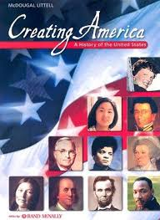
What did Europe look like in 1914?
Using the Historical American Atlas or Red Book
Label the countries on the Map of Europe in 1914
Color code them based on their alliances

