Slide 1
19-5 Causes of The Great War
Causes Cube

Slide 2
Warm Up
In what ways do you think the Industrial Revolution changed the way in which WW1 will be fought when compared to the Civil War that happened just 50 years earlier?

Slide 3
Cube Directions
Do not cut the cube until everything is completed.
Write in complete sentences.
Define the 4 causes of WW1.
Militarism, Alliance System, Imperialism, Nationalism
Give 2 example of how each term caused WW1.
Draw a colored image to represent each cause.
Make your name clearly visible on the “Militarism” side of the cube.
Each item must be placed in its proper spot!

Slide 4
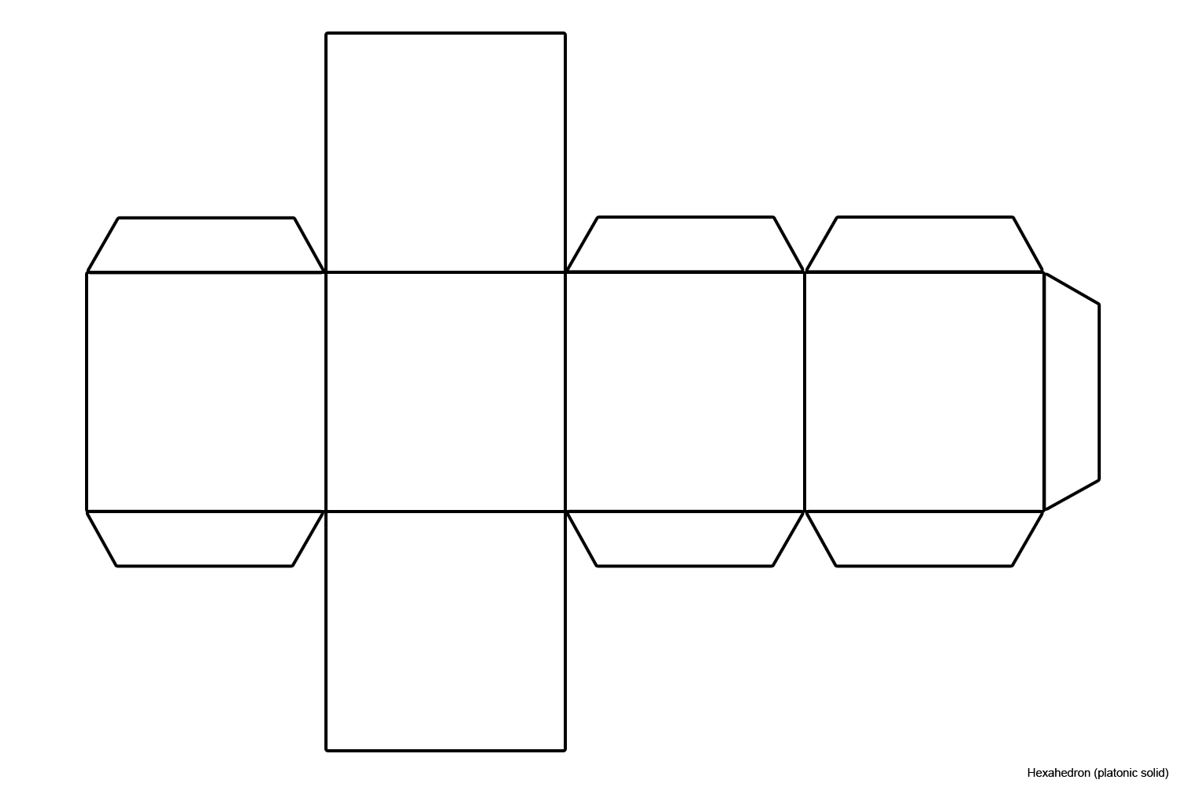
The Cube
Picture of Militarism
Picture of Alliance System
Militarism
Alliance System
Imperialism
Nationalism
Picture of Imperialism
Picture of Nationalism

