Slide 1
World War I & Its Impact on North Carolina
9-16 “The Great War”

Slide 2
Warm Up: Quote Analysis
1) Warm Up
“You will be home before the first leaves all from the trees”
– Keiser Wilhelm II to the German Troops
What does this quote say about the initial thoughts of the looming war?

Slide 3
Setting up the Dominoes
What sparked it?
Imperialism & the Alliance System
The “Catalyst”
Throughout 1800’s and early 1900’s-
Industrial nations fought 4 raw mat. & customers
They competed 2 build largest navy & strongest army
Tried to create largest empire
Called… Imperialism
Competition enflamed old hatreds & sparked new ones too!
To protect themselves…
Countries establish Alliance System
System of treaties that stated support for one another in the case of military actions against them
Austro-Hungarian Empire holds Bosnia as part of its empire
28 June 1914- Archduke Franz Ferdinand, heir to throne of A-H Empire, is assassinated by…
Gavrilo Princip
19yr. old Serbian student
Wanted Serbia, Bosnia, Herzegovina (Slavic nations) to become own free nation
Yugoslavia
Hoped this would start war b/t Slavs & A-H Empire
A-H Emperor outraged !!!
Austria declares war on Serbia
Serbia’s ally, Russia declares war on Austria
Austria’s ally, Germany declares war on Russia
Russia’s ally France gets in, and Germany declares war on France
To get to France, Germany must go through Belgium
Belgium’s ally (England) declares war on Germany
Slowly the dominoes fall, and the whole world gets involved

Slide 4
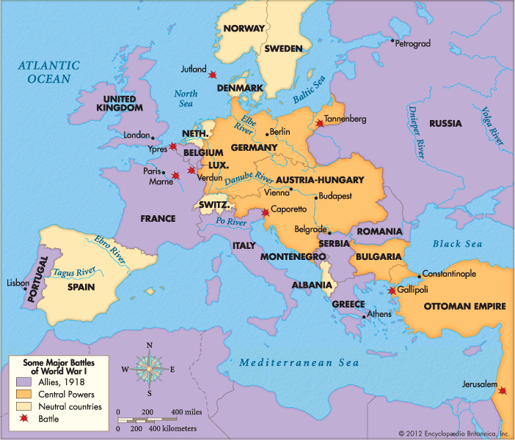
3) Name the 2 sides

Slide 5
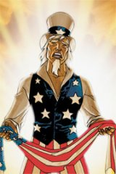
An Uneasy Neutrality
4) Your Opinion?
Central Powers- Austro-Hungarian, German, and Ottoman Empires
Allied Powers- Serbia, France, Russia, Belgium, England, Italy
At 1st…
USA tries to stay out
Declares neutrality, help neither side
President Woodrow Wilson urged neutrality but became sympathetic to Allied cause
Allies were mostly democracies
Had economic, and cultural ties to Allies as well
Central Powers were viewed as bullying empires

Slide 6
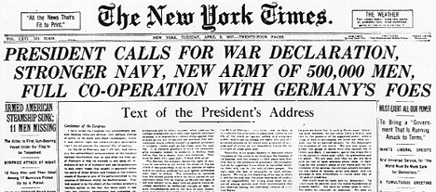
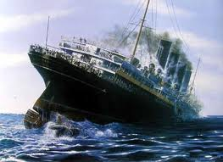
The United States Declares War
Germany’s war tactics make the decision for USA
Germans desperate to keep USA supplies from getting to Allies
May 1915- German U-Boat (submarine) sinks British passenger ship from NY to London
Lusitania (cruise ship)
100+ Americans died
President Wilson was outraged, but warned Germany not to mess w/ us again
Germany tests the waters
Alfred Zimmermann, Prime Minister of Germany
Sends telegram to Mexico
Urges them to join Central Powers and declare war on USA
The “Zimmermann Telegraph” was too much!!!
6 April 1917- USA declares war on Germany
5)Zimmermann Telegram
Notes:
Lusitania sinking video hyperlinked to pic of ship

Slide 7
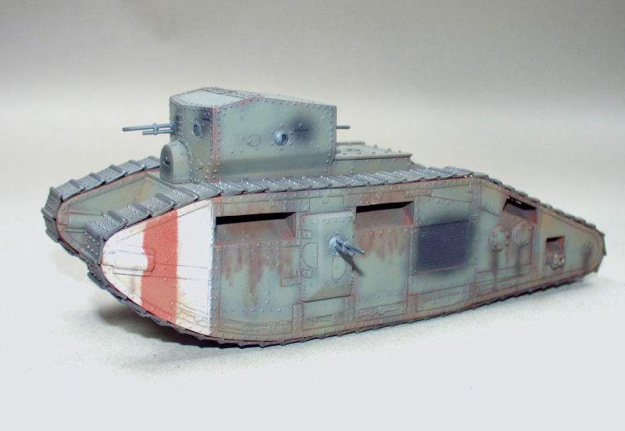
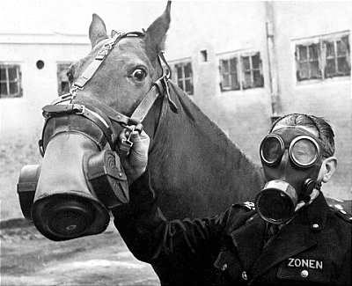
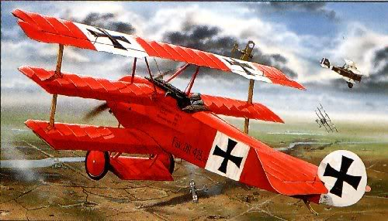
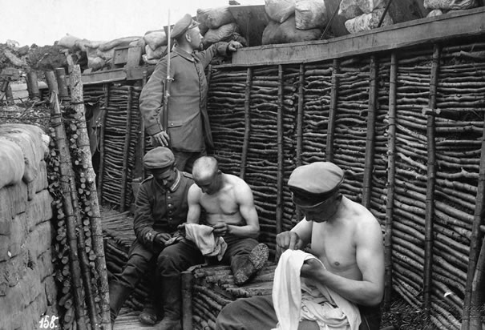
New Inventions
6) What invention would you fear?
During WWI, everyone used advances of Industrial Rev. to invent more deadly weapons
1860- machine gun invented, but perfected during WWI
Fired so fast…
Soldiers couldn’t protect themselves
Force the beginning of “Trench Warfare”
Soldiers dug 1,000’s of miles of trenches
Space of land /t the 2 sides and their trenches called…
“no man’s land”
Men could lay low
Fought and lived in the trenches for months at a time
Faced constant gunfire and diseased rats in the trenches
Other inventions added to brutality of war
Poison Gas
Tanks (1st used at Battle of the Somme
Airplanes and zeppelins used to bomb
After first 2 years of the war…
No one could tell who was winning
Wondered if it would ever end
7)Video Notes
Notes:
Trench warfare video hyperlinked to trench photo
World War One Trench Warfare (3:53)

Slide 8
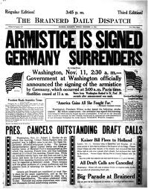
The Turning Point
8) Define Doughboy!
1917- series of events start to bring war to end
Feb. 1917- Russian people revolt against “Czar,” ruler
Tired of war, death, and starvation
7 Nov. 1917- new Russian gov’t est.
That gov’t signs peace treaty w/ Germany
Result…
Germans & Austro-Hungarians can send more troops against Allies in West
Russian out of picture…
Germans think win soon theirs , but…
June 1918- US “doughboys” arriving @ 250,000 per month!
By August, USA was pushing the Germans further and further east
Second Battle of the Marne (turning point)
Germans defeated, will never be on offensive again
German people had had enough!
Refused to fight any longer
9 Nov. 1918- German “Kaiser,” ruler gave up throne
Germany becomes a republic
11 Nov. 1918- Germans sign “armistace” cease fire agreement
11:00 am, the 11th hour, of the 11th day, of the 11th month.
9) Define Armistice

Slide 9
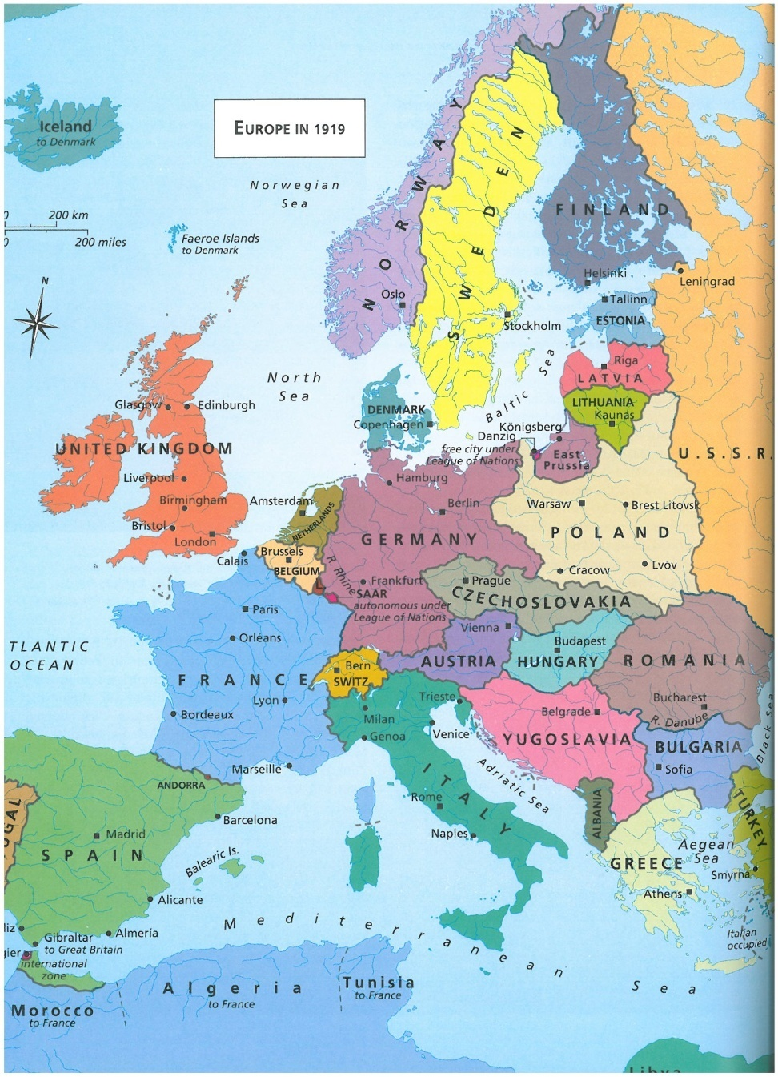
Making Peace
10) Treaty
11) What is the point of the League?
Jan. 1919- reps from 32 nations met in Paris to write the treaty
The losers were not invited
Treaty becomes known as the Treaty of Versailles
Placed all blame on Germany
Germany forced to give up all colonies
Pay all costs of the war too!!!
Allied clearly won, but many believe treaty was way to rub Germans nose it
Analogy… “Running up the Score”
Will become basis of WW2
Austro-Hungarian & Ottoman Empires were broken up & divided into several countries
US President Wilson called for something bigger
League of Nations (precursor to UN)
World governing body set up to settle conflicts b/t countries w/o war
US citizens didn’t want to be a part of it…
Wanted to stay neutral in world affairs and refused to become a member
League quickly folds w/o US support
Notes:
World War I - Treaty of Versailles (3:06)

Slide 10
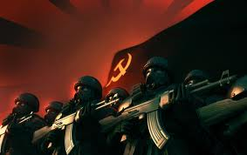
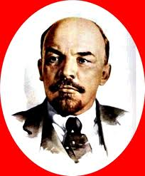
Changes in Russia
12) Revolution?
While debate of treaty was going on in Paris…
Russians in middle of civil war
Many groups battled for control
1920- Vladimir Lenin and Bolsheviks had won
Change name of country to Union of Soviet Socialist Republic, or USSR, or Soviet Union
Set up new gov’t based on ideas of Karl Marx, a German economist
Set up communism, economic system were peoples’ gov’t owns everything and profits divided equally
Homes, farms, land, crops, animals, etc

Slide 11
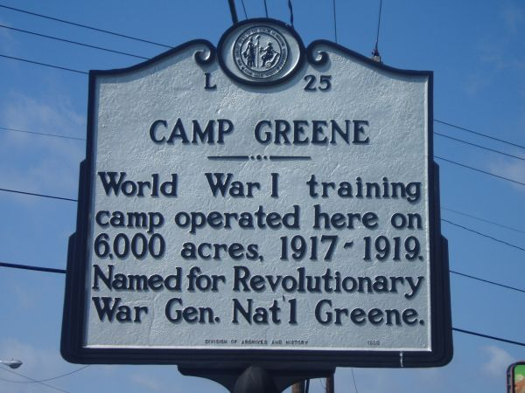
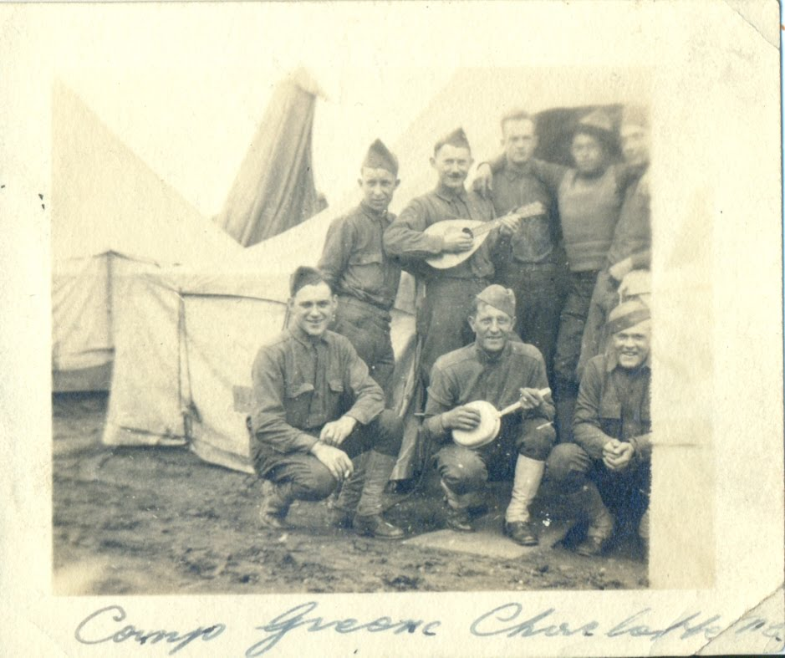
Effects of the War on North Carolina
Changes from WWI would leave the USA forever changed
116,000 US soldiers killed
Another 204,000 wounded
86,000+ NC soldiers fought in WWI
3 training camps were created in NC for US soldiers to train b4 deployment
Camp Greene in Charlotte
Camp Polk in Raleigh
Camp Bragg near Fayetteville
When the war ended, soldiers returned
Told tales of places and people they had seen
Gave many a new outlook on the world
Became critical of conditions at home
Lead to support drives for improvements w/in the state
Many became more tolerant of others ideas and cultures b/c of what they saw during the war overseas
14) Video Notes!
13) How is having bases in our state good for our economy?
Notes:
Hip Hughes Video Link hyperlinked on Camp Greene pix

Slide 12
Exit Ticket
What was the result of World War 1?
15) Recap!

