Slide 1
The Great War
9-17 WWI Satirical Maps

Slide 2
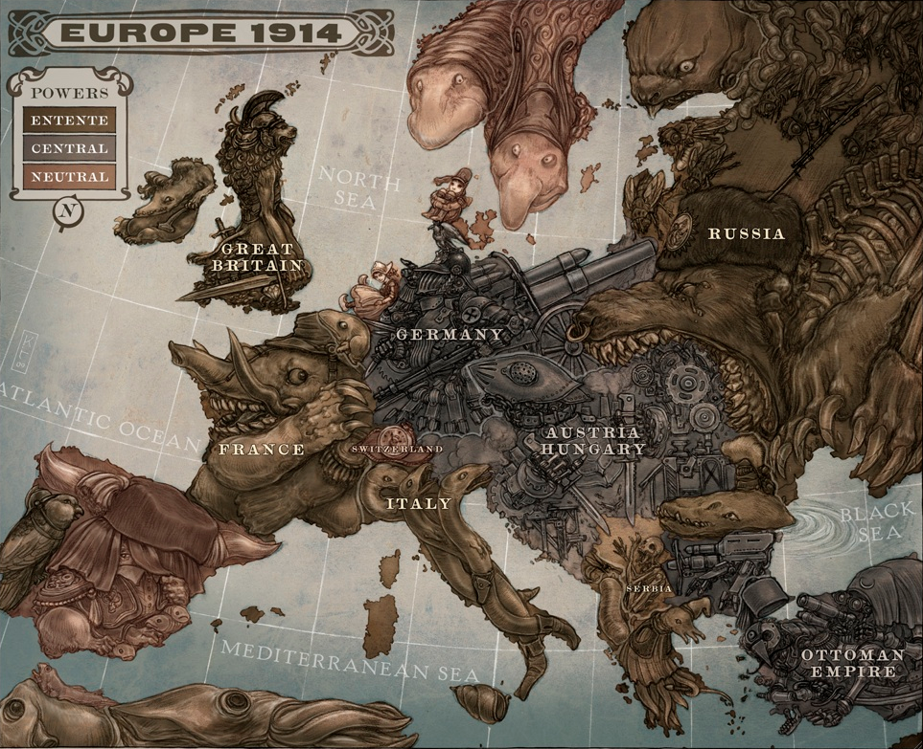

Slide 3
Map Explanation in the words of the artist, Keith Thompson:
The Clanker Powers - Germany is a massive military machine with weapons aimed outwards to all surrounding countries. It points threateningly at Britain, not so much as a sign of direct aggression, but more as an indicator that it was now Germany’s turn to start a grand global Empire to challenge the world’s current one.
Austria Hungary is an aggressive armoured giant, teetering on shoddy foundations. It is also the primary aggressor in a land grab against Serbia, with two bayonets piercing the border.
The Ottoman empire is a teetering automaton, collapsing under the weight of a paranoid and ungainly spying network that gazes at Europe through many lenses and spy glasses.
The Swiss watch ticks away the time, comfortable to wait it all out.
The Darwinist Powers - Britain is an militaristic lion beast with a Roman Imperial italic-type helmet. It sits upon a mound of riches gathered from its Empire.
France’s elephant beast (wearing the French kepi they started the war with before adapting their firefighter helmets) is influenced by the Elephantine Collossus built for the Universal Exhibition of 1889 in Paris (later it ended up going to the Moulin Rouge.) It also represents France’s huge significance in WWI.
Russia is a huge imperialist bear, rotting and filled with maggots.
Serbia’s imagery (a skeleton) is an indicator of the huge amounts of civilian deaths and suffering they’ll find themselves subject to.
Norway and Sweden are both Scandinavian trolls in the style of John Bauer, an incredible and inspirational illustrator from the time who produced a lot of phenomenal work during the war.
Portugal is a parrot for the Entente trying to goad a slumbering Spain into the war
Ireland looks askance to Britain and brandishes a shillelagh. An indicator of their very rough relationship at the time, and of their upcoming involvement with the Central powers.
Italy is a clutch of snakes with intents on the Central powers despite existing agreements. A foreshadowing of their arrangements at the secret 1915 Treaty of London where they were promised land in exchange for involvement.

Slide 4
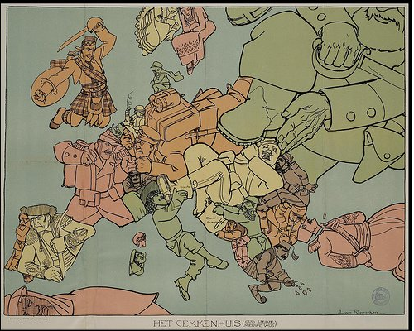

Slide 5
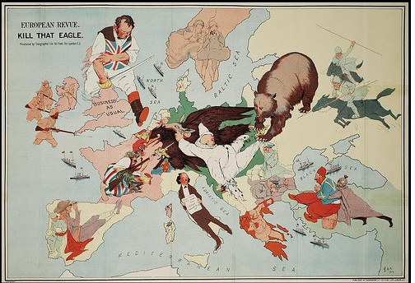

Slide 6
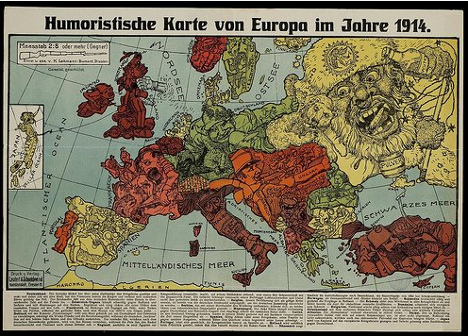

Slide 7
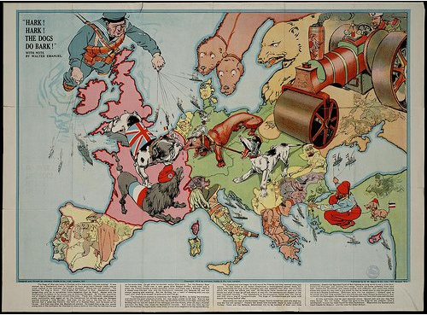

Slide 8
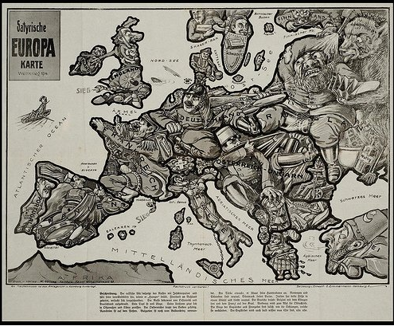

Slide 9
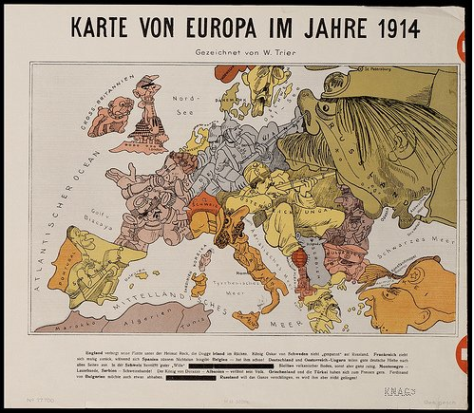

Slide 10
