Slide 1
Unit 9- Reform, Expansion, & War (1858-1914)
9-1 Diorama Model

Slide 2
Directions
Once you have received an era, you will create your diorama. You will have 3 days in class to research, fold, create and decorate your diorama model. Each student will be graded on their neatness, creativity, style, and presentation of their era’s information

Slide 3
Requirements
You must cover all the listed topics, as well as 2 influential people from your era, but may also include other topics within your era…
Musts:
-Computer generated background with a title
-minimum of eight (8) 3-D items that represent your chosen subject & two (2) 3-D pictures of influential people that sum up your era
-Notecard glued to the back with 3-4 paragraphs that sum up the basic concepts of your era
-Colored, & properly folded and glued before you come to class

Slide 4
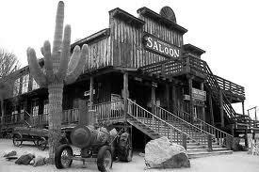
The West
Red Book Pages:
(pgs. 557-579)
Discovery Ed:
http://goo.gl/AFfQ5Q
Key topics:
Wild West, Native Americans, living in west

Slide 5
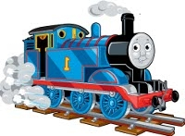
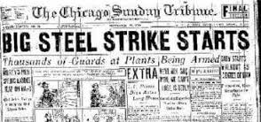
Industrial Age
Red Book Pages:
(pgs. 585-603)
Discovery Ed:
http://goo.gl/B6GB66
http://goo.gl/QnZ5iT
Key Topics:
Industrial Revolution, railroads, corporation growth,
Gilded Age, workers hardships, unions

Slide 6
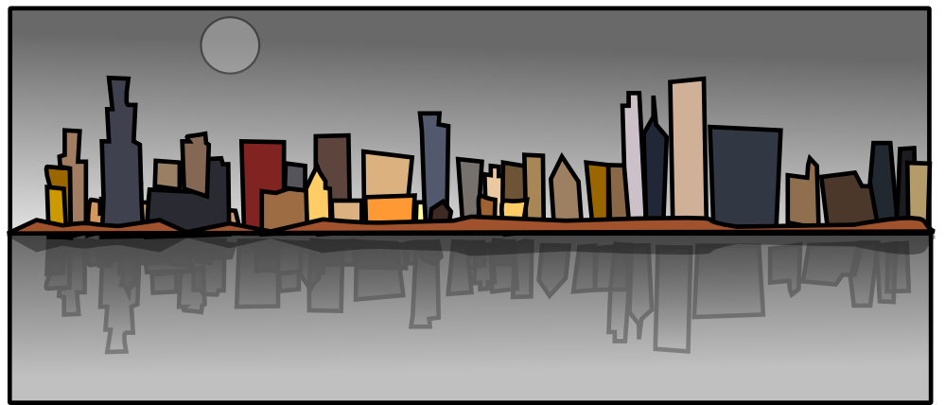
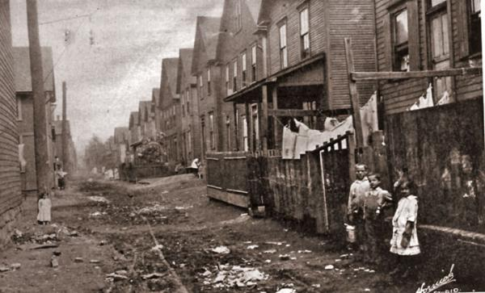
Changes in America
Red Book Pages:
(pgs. 609-629)
Discovery Ed:
http://goo.gl/gb7kze
http://goo.gl/7xaT3i
Key Topics:
growth of cities and technology, urban disasters, immigrants, mass culture and sports

Slide 7
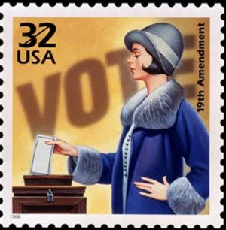
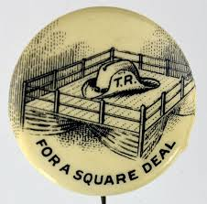
Progressive Era
Red Book Pages:
(pgs. 638-653)
Discovery Ed:
http://goo.gl/9dI3kV
http://goo.gl/3ikK2i
Key Topics:
reform, social welfare, Square Deal, 18th and 19th Amendments

Slide 8
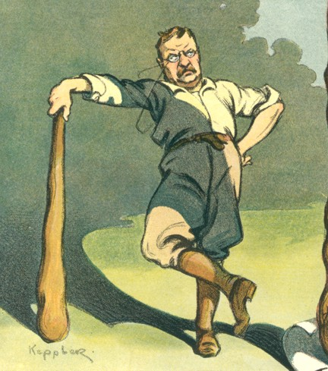
America Expands
Red Book Pages
(pgs. 659-673)
Discovery Ed:
http://goo.gl/f4keLy
Key Topics
Spanish American War, yellow journalism, pacific power, Panama Canal, trouble with Mexico, “walk softly and carry a big stick”

