Slide 1
The wild west
9-2 The Not So Wild West: MythBusters

Slide 2
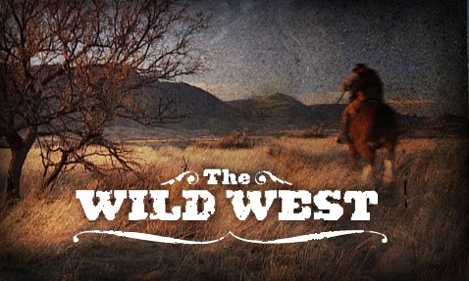
Warm up:
:
Describe what you see when I say “The Wild West.”
Draw a picture to represent this.

Slide 3
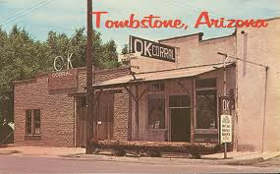
Background
The time known as the “wild west” took place in the mid-late 1800’s
The term frontier was used to describe what?
The furthest point west before the “wild west” were the frontier towns in Missouri.

Slide 4
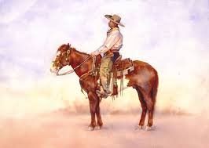
Background
Many different people headed west for different reasons
      Mining
      Cattle Farming
      Land
      Adventure
      Freedom
Westerners were not only white males but also newly freed slaves, Mexicans and Native Americans

Slide 5
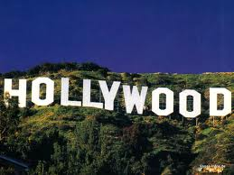
The West in Pop Culture
Often Hollywood has misled us on how the west really was…
  Can you think of any movies that may do this?

Slide 6
Wild West Stations Activity
You will read the Myth vs. Fact sheet with your group.
Next, with your group work to complete the chart on GoFormative for the particular myth you have.
When the buzzer goes off you will move on to the next station. You will have 8 minutes per station
Rinse and Repeat.

Slide 7
Exit Ticket: Recap!!!
What have you learned about the wild west?
How does your new knowledge about the real wild west compare to what you used to think about it?
Why do you think we have this false image of the wild west in our heads?

