Slide 1
The wild West
9-3 Who Went West?

Slide 2
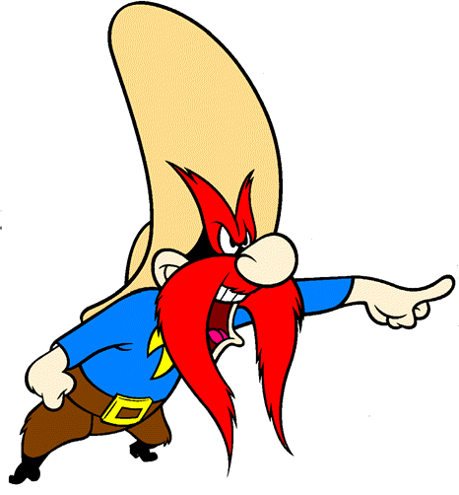
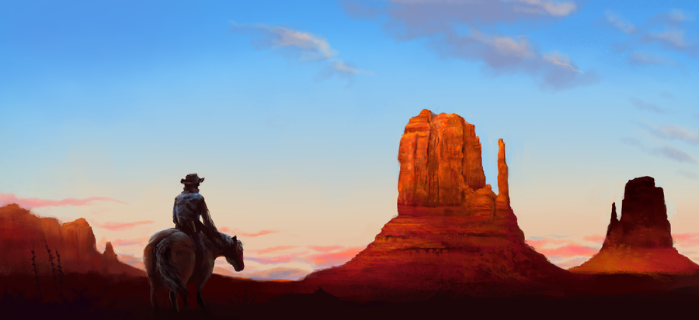
Warm up: Spiral Review
What was one myth you learned yesterday about the wild west?
Why did this myth come about?

Slide 3
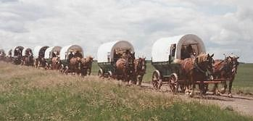
Who Went West Jigsaw
The class will be split into 4 groups.
Silently read the passage assigned to you about a specific group who went west.
When instructed, as a group you will work to fill in your chart for your group. You will be the expert on that group. DO NOT READ OTHER GROUPS READINGS
You will be assigned to “teach” your info to others and they will teach you about theirs. You cannot pass your sheet around.
Record (NOT COPY) the other groups into your chart.

Slide 4
Discovery Education
Open GoFormative and access “9-3 Discovery Ed Chart”
Click the following link after you have logged-in and read on discovery education to complete the chart on goformative
http://goo.gl/sgQu36
-click explore!
This is homework if not completed in class!!!

