Slide 1
9-4 Modern Industrialization
The Search for the American Dream

Slide 2
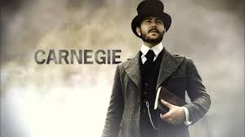
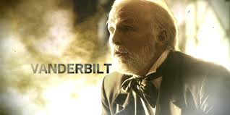
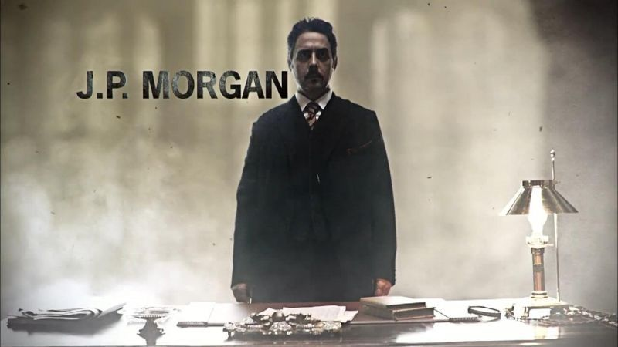
Warm Up: What is the American Dream?
Complete the Survey using GoFormative… Answer the questions completely
Use your own ideas and ideals to answer them
DO NOT click “Submit”

Slide 3
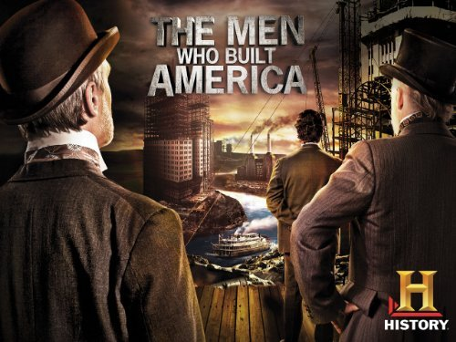
Captains of Industry, Robber Barrons, or BOTH?
The Men Who Built America
The men listed below were the Men who, both literally and figuratively, “built America.”
Cornelius Vanderbilt
Andrew Carnegie
JP Morgan
John D. Rockefeller
Thomas Edison
Henry Ford
We are the USA that you know because of them.
We will watch the History Channel’s production The Men Who Built America

Slide 4
Intro
https://www.youtube.com/watch?v=gR7oHh-fXUw&list=PLLu9cJdiEWz8qNYy-uv49gAkMQYLZGUa1&index=1
Vanderbilt
https://www.youtube.com/watch?v=EpvlojMnhOA
Carnegie
https://www.youtube.com/watch?v=-_GQuhOK_lc
JP Morgan
https://www.youtube.com/watch?v=IhoeurGDnG0&list=PLTtaJzaEoQeLOEF2QnSg_ApKi12_V2R0m&index=4
Rockefeller
https://www.youtube.com/watch?v=O2BKPeHNkxU
Thomas Edison
https://www.youtube.com/watch?v=mn8uGDg_5fA
Henry Ford
https://www.youtube.com/watch?v=R63D3AbDTOU

