Slide 1
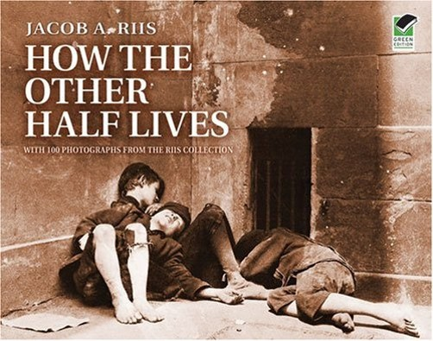
9-6 How the Other Half Lives Urbanization and Immigration

Slide 2
Warm up: Spiral Review
1) Warm Up
After looking at and reading about working conditions yesterday, why do you think people put up with them on a daily basis?
If someone was to “speak up” what do you think was done about it?

Slide 3
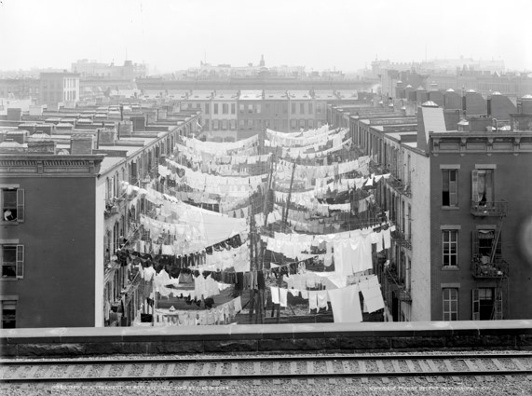
Tenement Tour
2) Tenement
A tenement was a run-down and often overcrowded apartment house, especially in a poor section of a large city.
Take a virtual tour of a tenement house:
http://www.tenement.org/Virtual_Tour/index_virtual.html

Slide 4
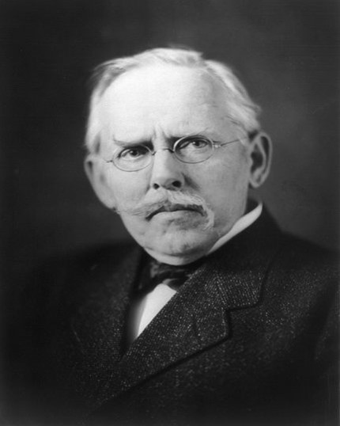
Jacob Riis was a Danish-born muckraker who sought to improve the lives of the poor in New York City.
3) Define!
Wait… What in the heck is a muckraker?
Help Jacob Riis, define muckraker!

Slide 5
This photograph shows conditions in the back alleys of a tenement, where clotheslines hung.
How the Other Half Lives,
By Jacob Riis

Slide 6
A blind beggar sells cigars on the street, hoping to make enough money to pay for a meal and a bed.
How the Other Half Lives,
By Jacob Riis

Slide 7
This photograph shows children moving trash one wheelbarrow at a time – exposing child labor.
How the Other Half Lives,
By Jacob Riis

Slide 8
These children are sleeping outdoors – huddled together for warmth.
How the Other Half Lives,
By Jacob Riis

Slide 9
How does this passage make you feel?
4) Stop and Jot!
…Bodies of drowned children turn up in the rivers right along in summer whom no one seems to know anything about. When last spring some workmen, while moving a pile of lumber on a North River pier, found under the last plank the body of a little lad crushed to death, no one had missed a boy, though his parents afterward turned up…

Slide 10
The poor were frequently found drunk or ill to the point of death on the streets. Freezing to death was entirely possible.
How the Other Half Lives,
By Jacob Riis

Slide 11
Many impoverished citizens of New York shared shanties like these, squatting on the land in back alleys.
How the Other Half Lives,
By Jacob Riis

Slide 12
The immigrant family above is pictured with all of the family’s possessions.
How the Other Half Lives,
By Jacob Riis

Slide 13
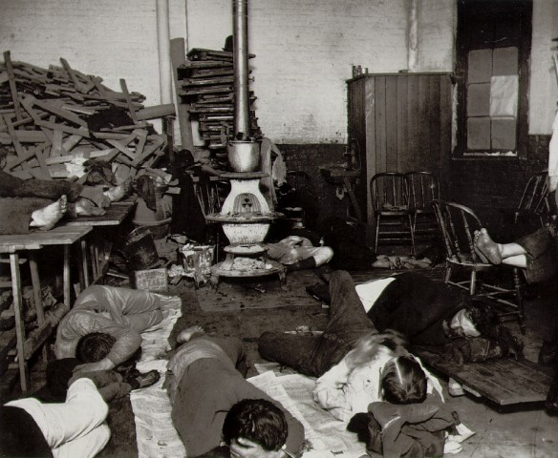
This photograph shows the Men’s Lodging Station on 47th Street.
How the Other Half Lives,
By Jacob Riis

Slide 14
Garment workers might work 14 to 16 hours a day, being paid by the piece – and not very well, often working in their own tenements…
How the Other Half Lives,
By Jacob Riis

Slide 15
This man is spreading his sleeping tic on top of two barrels – the basement will very likely flood.
How the Other Half Lives,
By Jacob Riis

Slide 16
Frequently, low paid workers would try to save money by sharing a room. Overcrowding bred disease.
How the Other Half Lives,
By Jacob Riis

Slide 17
Riis asked his readers to consider: Does the poor baby in this photograph inherit justice and equality? Or does the United States need to take action to insure that working people can provide for the basic needs of their families?
How the Other Half Lives,
By Jacob Riis

Slide 18
The Effects of Jacob Riis’ How the Other Half Lives
Riis’ work brought attention to the conditions in which poor workers and immigrants lived in New York City and other major cities across America.
The emphasis Riis put on ending child labor and improving public schools in America helped reformers like Horace Mann establish public schools and helped labor unions to end child labor.
Riis’ work inspired members of the settlement house movement, like Jane Addams, the founder of Hull House.
The 16th Amendment to the Constitution, which created a graduated income tax system was adopted when Americans became increasingly aware of the disparity between the wealth and the very poor.
5) 1st Person!
How would you respond to seeing these photos if you were alive at that time, would you do anything about it?

Slide 19
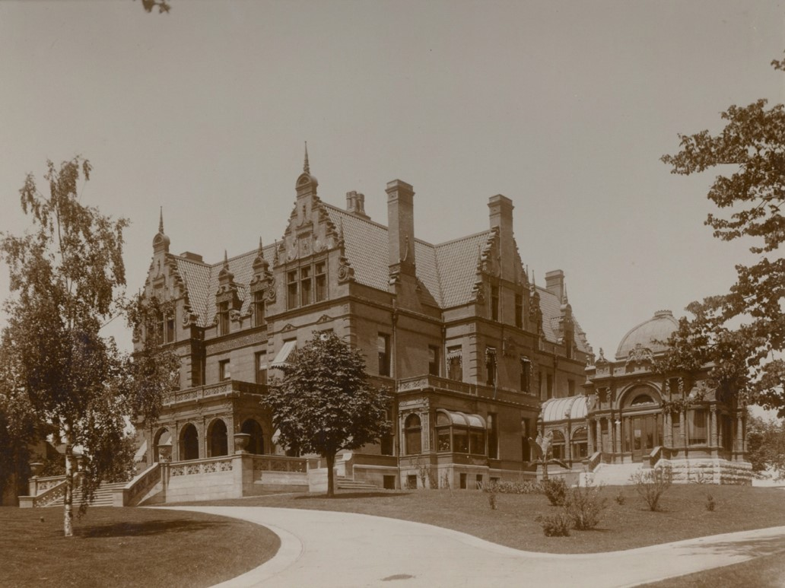
The Mansions of the Gilded Age

Slide 20
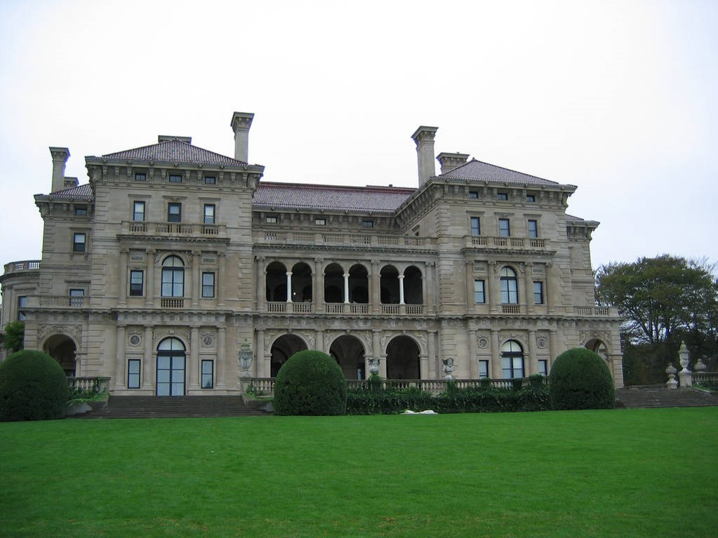
Breakers Mansion (Vanderbilt’s summer home):
Newport, Rhode Island

Slide 21
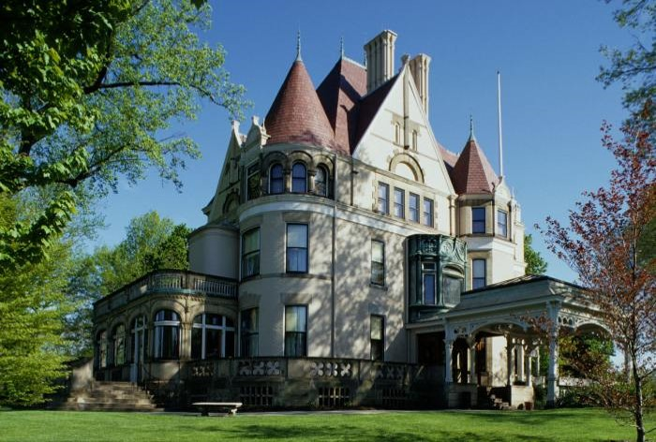
Clayton (Frick House): Pittsburgh, PA

Slide 22
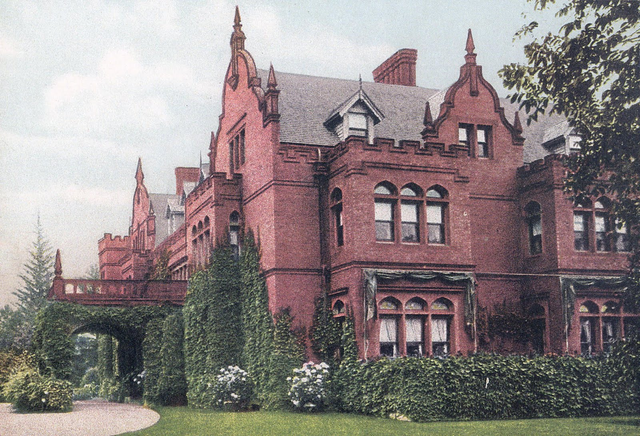
Ventfort Hall: Lenox, Massachusetts
(owned by sister of JP Morgan)

Slide 23
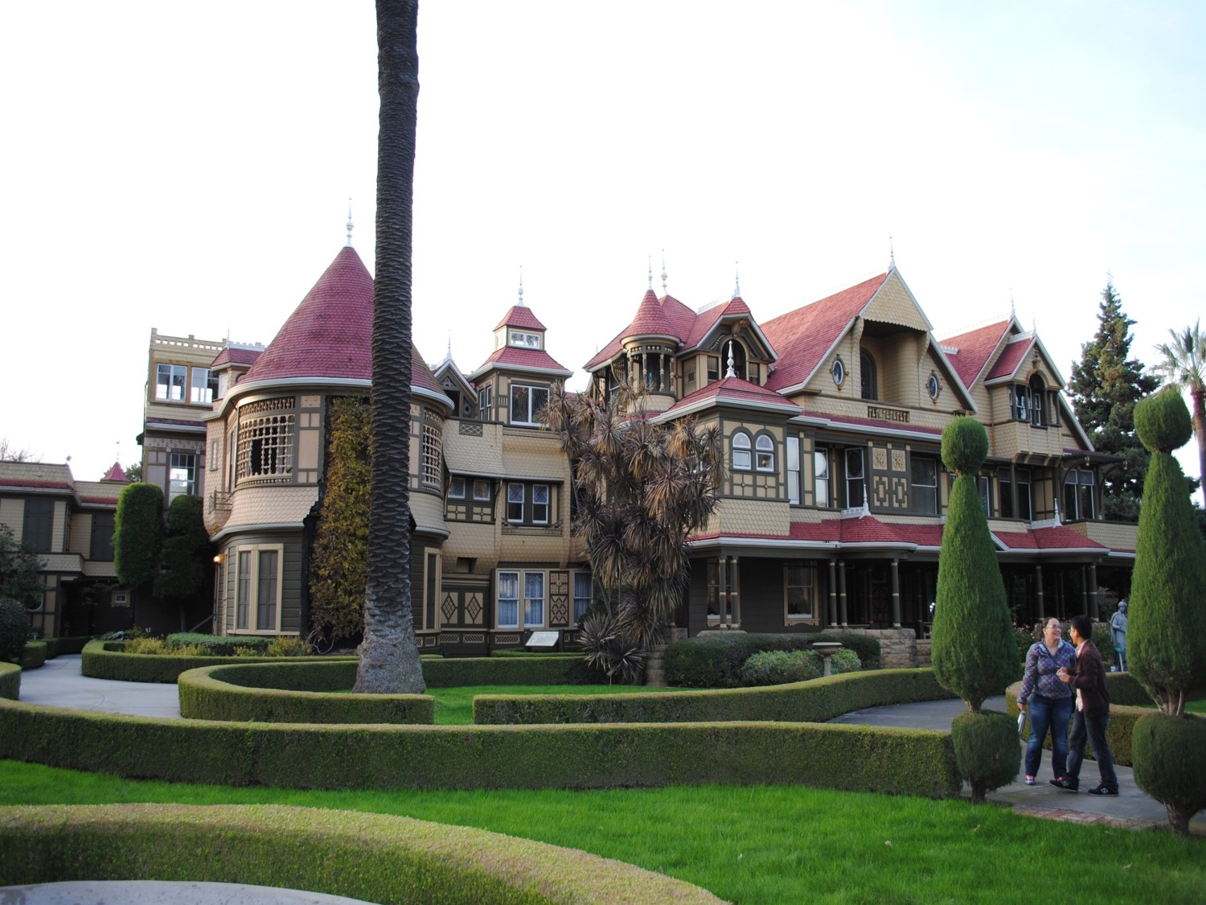
Winchester “Mystery House”
San Jose, California

Slide 24
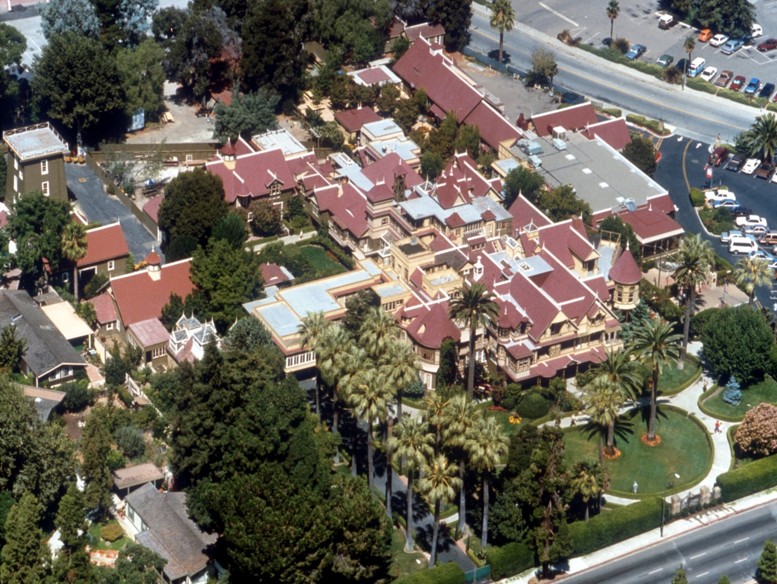
Winchester “Mystery House”
San Jose, California

Slide 25
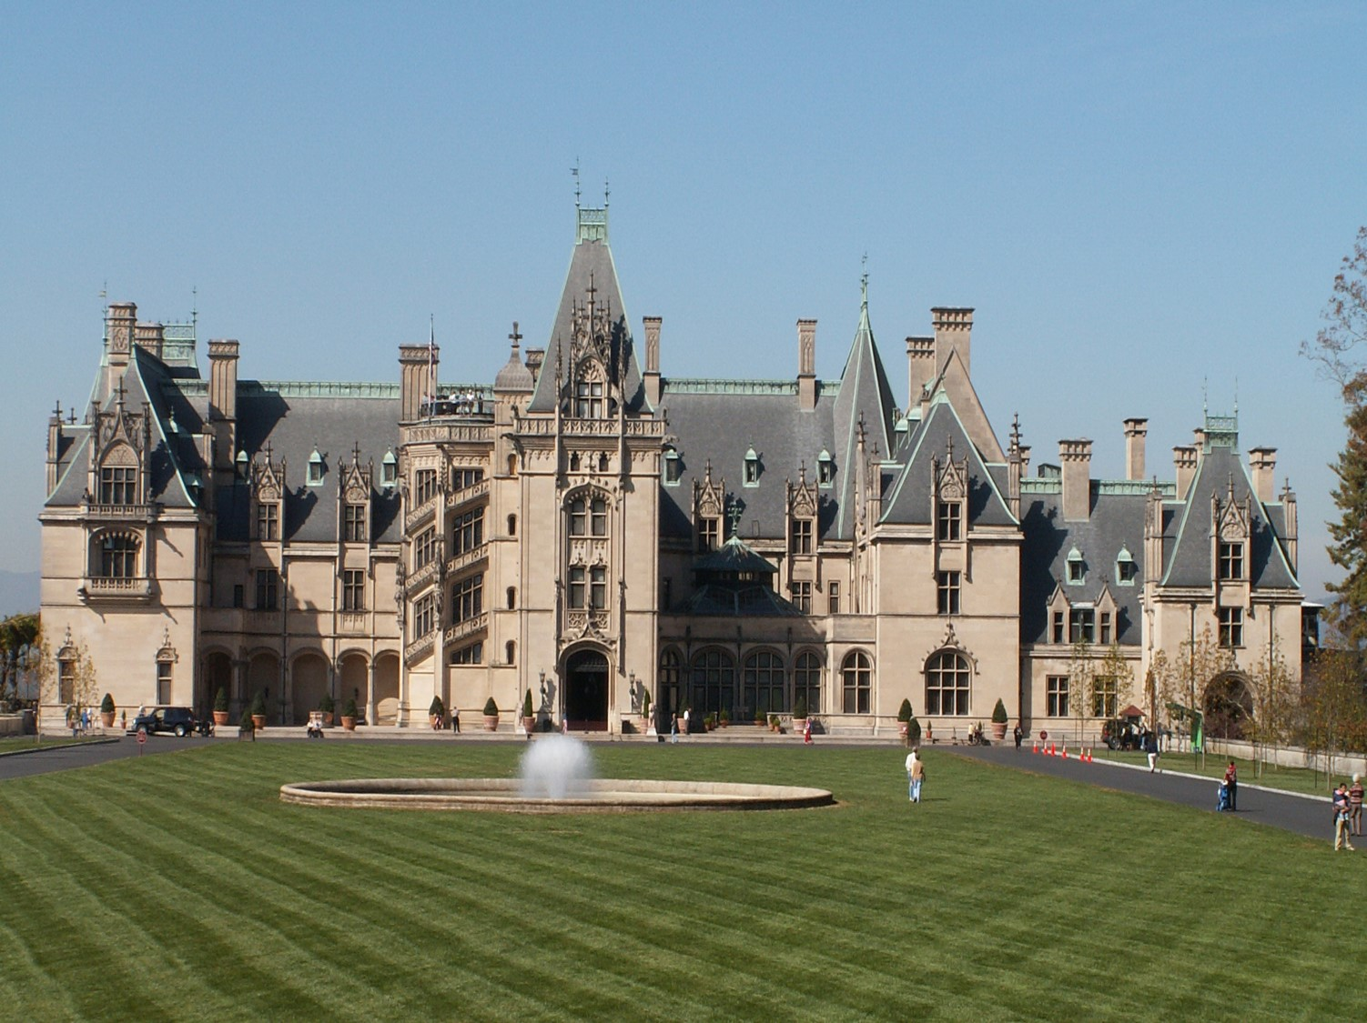
Biltmore Estate:
Asheville, North Carolina

Slide 26
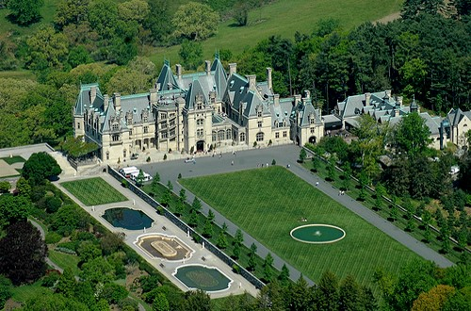
Biltmore Estate:
Asheville, North Carolina

Slide 27
Compare and Contrast
6) Venn Diagram!
Complete on goformative.com!

Slide 28
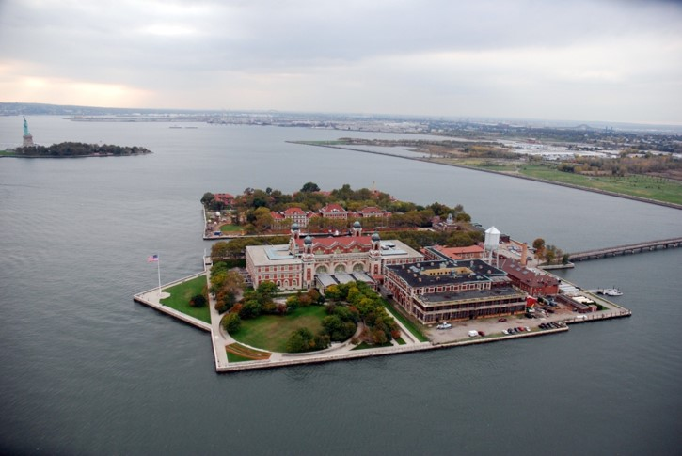
Mission US: A City of Immigrants
Sign up for an account.
Use your user ID and password for the Chromebook®.
You will play the game and make choices as an immigrant. See where you end up!
http://www.pbslearningmedia.org/resource/mu10.vk8soc.7-8.newnation.cityim/mission-us-city-of-immigrants/
Note that the Statue of Liberty is not on Ellis Island!
7)What result?
Ellis Island

