Slide 1
Unit 9- Reform, Expansion, & War
9-7 Immigration Blendspace®

Slide 2
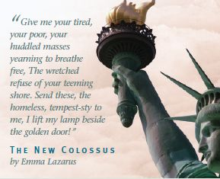
Immigration & Ellis Island
An Immigrant Journey from Europe to the Land of the Free!
Follow the self-guided tour from the journey itself, arrival at Ellis Island, processing, and transplantation to a major urban area!!!
https://www.tes.com/lessons/Gbriy7JxIKeW-g/immigration-and-ellis-island

