Slide 1
America EXPANDS
9-9 American Imperialism

Slide 2
Warm up: Inferences
Warm up
1) To the left is a political cartoon of Uncle Sam that depicts the concept of Imperialism. Based on this cartoon, what inferences can be made about the term Imperialism?

Slide 3
Imperialism /imˈpirēəˌlizəm/
Merriam Webster defines imperialism as:
a policy or practice by which a country increases its power by gaining control over other areas of the world
Dictionary.com defines imperialism as:
a policy of extending a country's power and influence through diplomacy or military force.
2) Make your own definition with less than 7 words
Define!

Slide 4
America’s changing policy of imperialism
“The Great rule of conduct for [the U.S.],
in regard to foreign Nations is in extending our commercial relations to have with them as little political connection as possible... 'Tis our true policy to steer clear of permanent alliances, with any portion of the foreign world”
—George Washington, Farewell Address (1796)
3) Based on president Washington’s address, what was the American attitude towards imperialism in the late 1700’s?
Primary Source
Analysis

Slide 5
America’s changing policy of imperialism
“The American continents…are henceforth not to be considered as subjects for future colonization by any European powers. We should consider any attempt on their part to extend their system to any portion of this hemisphere as dangerous to our peace and safety”
—The Monroe Doctrine (1823)
Primary Source
Analysis
4) Based on president Monroe’s foreign policy doctrine, what was the American attitude towards imperialism in the mid 1800’s?
5) Has it changed since the 1700s?

Slide 6
America’s changing policy of imperialism
“The American claim is by the right of our manifest destiny to overspread and to possess the whole of the continent which Providence has given us for the development of the great experiment of liberty and federated self-government entrusted to us”
—John O’Sullivan, New York Morning News (1845)
Primary Source
Analysis
6) Based on the idea of Manifest Destiny, what was the attitude of expanding America in the mid 1800’s?

Slide 7
America’s changing policy of imperialism
“American factories are making more than the American people can use; American soil is producing more than they can consume. Fate has written our policy for us; the trade of the world must and shall be ours.” —Senator Albert Beveridge (1898)
Primary Source
Analysis
7) Based on this quote from a U.S. Senator, what was the attitude of imperialism in the late 1800’s?
8) How does this compare to the earlier opinions of imperialism you just read?

Slide 8
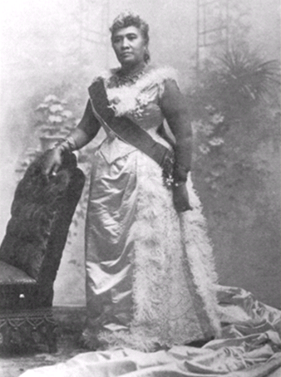
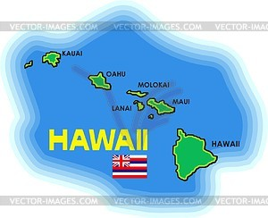
Imperialism in the pacific- Hawaii
11) Annexed
Americans moved to Hawaii between 1820-1890 as missionaries.
America acquired Midway Island, as it was seen as a good stopping point for US ships sailing between Asia and the west coast
We soon realized we wanted Hawaii as well
Naval base, sugar plantations, shipping ports
In 1898 Queen Liliuokalani was overthrown and the USA annexed Hawaii.
To add (territory) to one's own territory

Slide 9
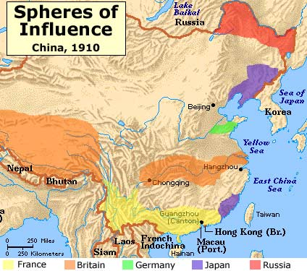
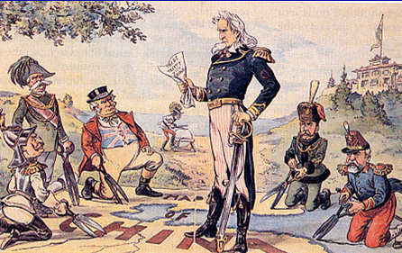
Imperialism in the pacific- China and Japan
By the late 1890’s Japan and other European countries had established spheres of influence in China
Sections within China were that country could enjoy special powers and trading privileges
America wanted in, but thought it was too late
Proposed Open Door Policy:
Would allow all countries to freely trade within each other’s sphere of influence
Eventually the Chinese rebelled against these policies in their country
Boxer Rebellion- Attacked Beijing before being defeated
Japan began to ignore the Open Door Policy and started a war with Russia
Russo- Japanese War
Led to an increase of discrimination against Japanese Americans
10) Is it fair?
10) In what ways was the Open Door Policy unfair to the Chinese?

Slide 10
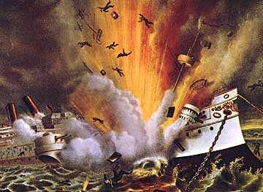
Spanish American War
Cuba tried unsuccessfully to overthrown their Spanish rule. As a result the Spanish cracked down hard on the Cubans.
President McKinley was pressure to send help
Sent the U.S.S Maine to sit in the harbor outside Havana, Cuba
Sat quietly for week
Feb. 15, 1898 it EXPLODES!
American Newspapers immediately blame the Spanish
Later details point to the explosion as an accident
Newspapers had blown this story, and many others out of proportion to get readers engaged and excited about stories.
This style of writing is called Yellow Journalism
Embellishing stores to make readers read your story
11) Yellow Journalism
11) Define. Do you think writers still use tactics similar to yellow journalism today,? If so give me an example.

Slide 11
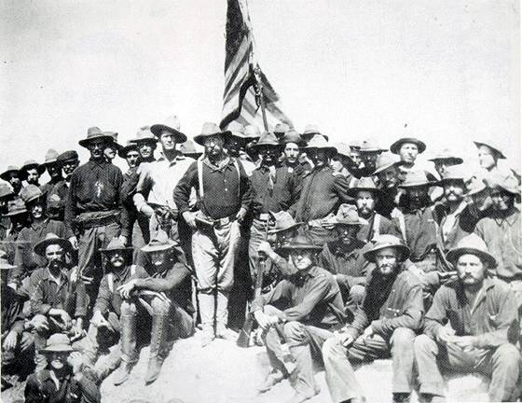
Spanish American War
Although the war started in Cuba the first fighting occurred in the Philippines
Teddy Roosevelt quit his job as Assistant Sec. of the Navy to lead the Rough Riders
Calvary Unit in Cuba
After 4 months terms were agreed upon
Cuba became a US Protectorate
Puerto Rico and Guam become US Territories
Spain gives up Philippines to US for $20 million
Teddy Roosevelt with the Rough Riders being a boss.

Slide 12
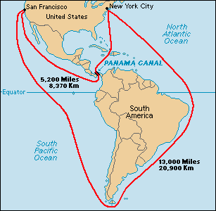
Panama Canal
Think about it!
It had been long dreamed of: A canal to make the trip around South America safer and shorter…
America acquired a lease for a plot of land in the country of Panama that bordered the Atlantic and Pacific Oceans
Panama is less than 50 miles shore to shore
The canal was completed August 15th 1914
Cut over 7000 miles off the journey from New York and San Francisco
12) What advantages did the Panama Canal create?

Slide 13
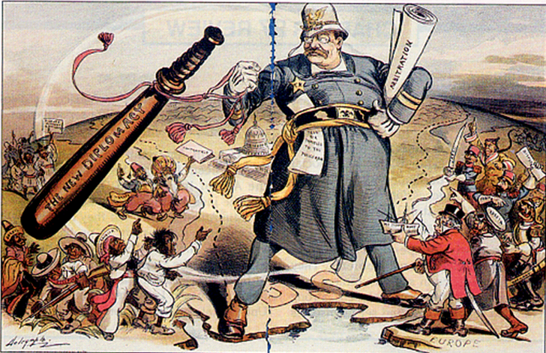
Imperialism in Latin America
Roosevelt used “Big Stick Diplomacy” to get what he wanted in Latin America and elsewhere
“Walk softly but carry a big stick”
Used negotiation tactics first but scare them into agreeing by “flexing our military muscles”
The building of the Panama Canal ensured U.S. involvement in Latin America for years to come.
Roosevelt was worried about political instability in Latin America and the Caribbean so he created the Roosevelt Corollary.
Policy asserting America as “police” in Latin America
President William Taft’s foreign polices were referred to as Dollar Diplomacy
Idea that expansion of American businesses and investments into troubled areas of the world would bring stability.
Define!

Slide 14
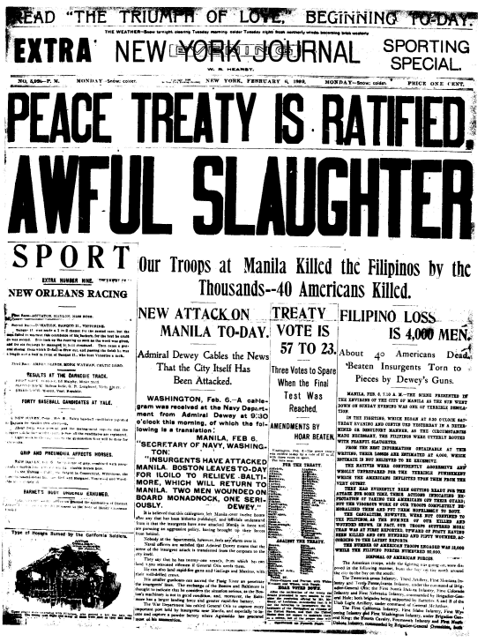
Yellow journalism
You will watch the episode of SpongeBob on the next slide and answer the following question on goformative.
14) How is the reporting that SpongeBob did considered “yellow journalism?”
Compare!
Click “Submit” when finished!

Slide 15
SpongeBob Square pants: The Krabby Kroncile
Click to video to watch

Slide 16
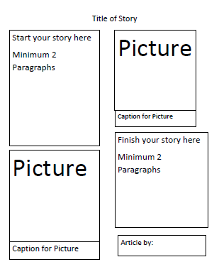
Yellow Journalism Assignment- EXTRA CREDIT!!!
Due Next Friday
Using the designed template I created for you, you will make a yellow journalism article of your own.
Remember, yellow journalism takes a true story but “bends the truth”, changes some facts and makes a catchy title to grab readers attention rather than telling the truth.
Topics: Choose one
1) Deflategate (New England Patriots football issue)
2) The “snow storm” that we had resulting in school cancelations
3) Global Warming
4) Choose your own Topic (ONLY IF YOU CURRENTLY HAVE AN A IN THIS CLASS!)

