Slide 1
New Plan Moving Forward
Positive Re-enforcement & Competitive Nature

Slide 2
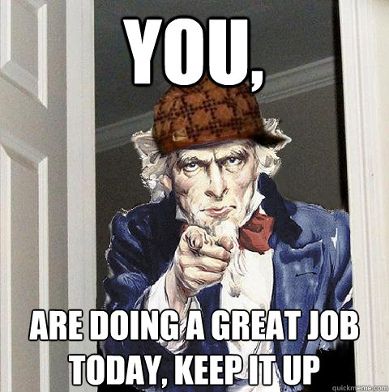
Nailed It! ® Board
Tests / Quizzes / Projects
Every student that receives a 100%...
Get to write their name on a Bronco Cutout
Tack it on the Nailed It! ® Board
Receive a piece of candy
Exceptional Classwork / Homework
Mr. Waz will hang student work on Nailed It! ® Board
Students will receive a piece of candy

Slide 3
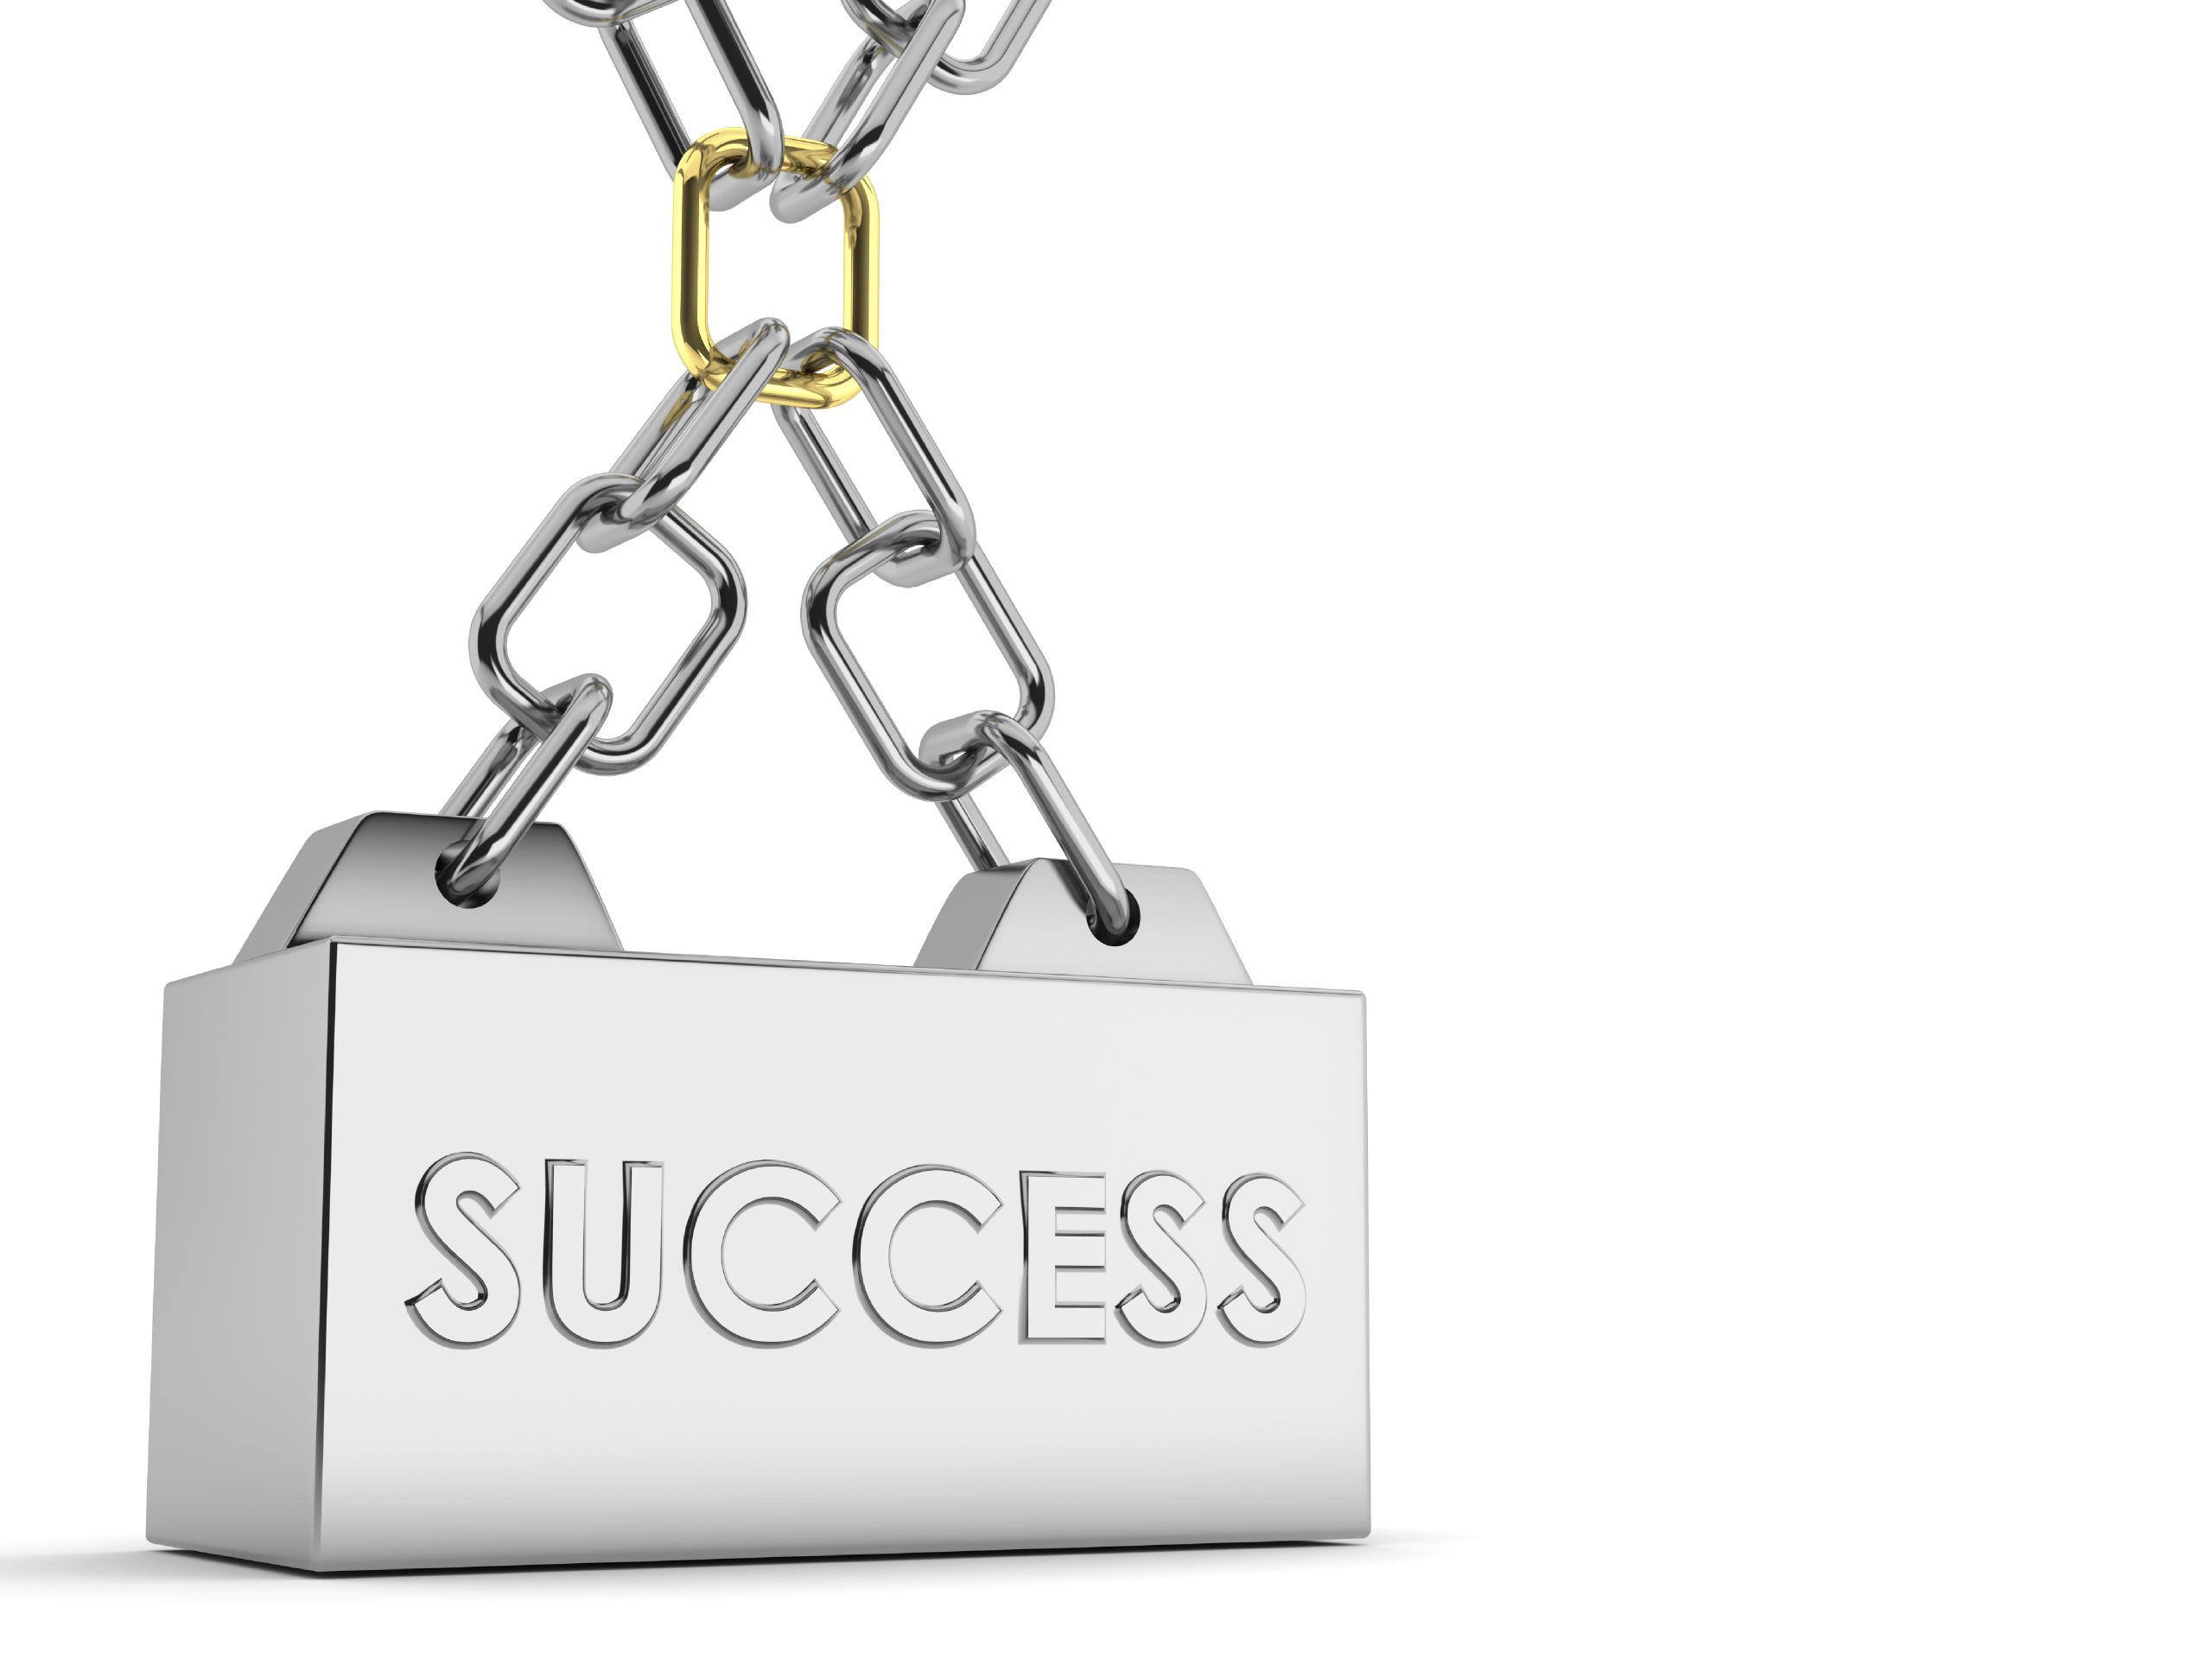
Chain Challenge ®
Bkgd-
Classes will compete to earn chain links for Dailey positive behaviors
Each positive behavior earns the class a chain link
The class at the end of the quarter with the most links will win a pizza party
Paid for by the great & powerful waz
Ways to earn links
Warm-up done in timely manner
In-class Participation & behavior
Homework 100% completed on time
10% of class gets 100% on formal assessments
Class with highest overall test average
Class with highest overall gpa (Weekly)
Class with least amount of missing work (Weekly)

Slide 4
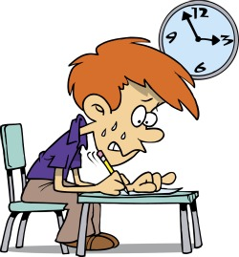
Re-Takes of Tests
Re-takes will only occur the week following the return of the test grades
Students can only re-take on their assigned day
Students must have a completed study guide prior to re-take
Students must return original signed scan-tron
Assigned Days
Tuesday- Red & yellow
Thursday- Green & blue

Slide 5
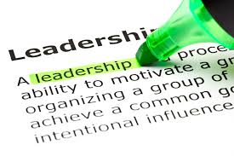
Classroom leadership roles
Chain Gang
Student who attaches chain links for class
Paper passer-outer
Student who passes out graded work
Keeper of the Chromes
Student who plugs chromes in in the afternoon
Student who unplugs and puts out chromes in morning
Fact-finder
Student who will search out random facts for unknown questions
Student tutors
Student volunteers who will come in during working lunch to help re-loop student who need assistance

